Slide 1
Fraudulent Claim Detection
Summary of Findings, Recommendations, and Business Implications
By : Lekhana and Kumar Kumar

Slide 2
Problem Statement
• Context: Global Insure processes thousands of claims annually, with significant financial losses due to fraudulent claims.
• Challenge: Manual inspections are time-consuming and detect fraud too late, after payouts.
• Objective: Build a model to classify claims as fraudulent or legitimate early in the approval process.
• Questions:
• How to analyze historical data for fraud patterns?
• Which features predict fraud?
• Can we predict fraud likelihood for new claims?
• What insights improve fraud detection?

Slide 3
Data Overview
• Dataset: 1000 claims, 40 features.
Target: fraud_reported (Y/N)
• Key Features:
• Customer: months as customer, age, education, occupation.
• Policy: premium, deductible, umbrella limit.
• Claim: total claim amount, incident severity, police report.
• Vehicle: auto make, model, year.

Slide 4
Methodology
• Data Preparation: Loaded and cleaned data, handled missing values, encoded categoricals.
• Train-Validation Split: 70-30 (700 training, 300 validation), stratified by fraud status.
• Exploratory Data Analysis (EDA):
• Boxplots for claim amounts.
• Bar plots for fraud rates by incident type, auto model.
• Correlation heatmaps for numerical features.
• Feature Engineering: Created claim-to-premium ratio, selected important features.
• Models: Logistic Regression (baseline), Random Forest (advanced).
• Evaluation Metrics: Accuracy, sensitivity, specificity, precision, F1-score.

Slide 5
Key Findings
• Fraud Patterns:
• Minor or trivial damage incidents often fraudulent.
• Claims without police reports have higher fraud rates.
• New customers and specific auto models
• Model Performance:
• Logistic Regression: 54.55% accuracy, 85.29% sensitivity.
• Random Forest: 76.92% accuracy, 85.29% sensitivity.
• Predictive Features: Incident severity, claim amounts, customer tenure, auto model, police report availability.

Slide 6
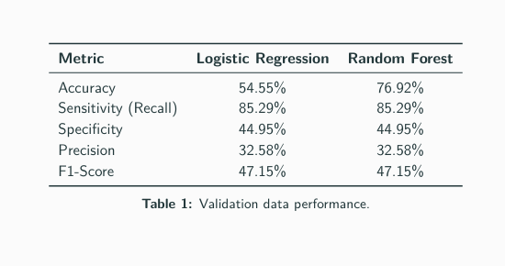
.

Slide 7
Answers to Key Questions (1/2)
1. How to analyze historical claim data for fraud patterns?
• Use EDA: Boxplots for claim amounts, bar plots for fraud rates by incident severity, auto model, and heatmaps for correlations.
• Example: Minor damage claims have higher fraud rates; new customers show anomalies.
2. Which features are most predictive of fraud?
• Incident severity (minor/trivial damage).
• Claim amounts (total, injury, property, vehicle).
• Customer tenure (shorter tenure riskier).
• Auto model (e.g., 92x, Civic, Escape).
• Police report availability (missing reports riskier)

Slide 8
Answers to Key Questions (2/2)
3. Can we predict fraud likelihood for incoming claims?
• Yes, Random Forest predicts fraud with 76.92% accuracy and 85.29% sensitivity.
• Model uses historical features to score new claims in real-time.
4. What insights improve fraud detection?
• Flag minor damage claims, new customers, and claims without police reports.
• Integrate model for real-time predictions.
• Enhance with behavioral data or external fraud databases.

Slide 9
Recommendations
• Deploy Random Forest Model: Integrate into claims processing for real-time fraud scoring.
• Flag High-Risk Claims:
• Minor or trivial damage incident
• No police report.
new customer or specific auto models
• Optimize Manual Reviews: Prioritize claims predicted as fraudulent to reduce workload.
• Continuous Updates: Retrain model with new claim data to adapt to evolving fraud patterns.
• Enhanced Verification: Stricter checks for high claim-to-severity ratios

Slide 10
Business Implications
• Financial Savings: Reduced payouts on fraudulent claims, potentially saving millions annually.
• Operational Efficiency: Automated fraud scoring speeds up claims processing and reduces manual review workload.
• Customer Trust: Fairer claim handling enhances reputation and customer satisfaction.
• Scalability: Model integrates easily into existing systems for real-time decision-making.

Slide 11
Conclusion
• Summary: Random Forest model achieves 76.92% accuracy and 85.29% sensitivity, effectively detecting fraudulent claims.
• Key Predictors: Incident severity, claim amounts, customer tenure, auto model, police report.
• Next Steps:
• Deploy model in production.
• Incorporate additional data (e.g., behavioral patterns).
• Establish monitoring and retraining pipeline.

